Slide 1
Towards Better Product Quality: Identifying Legitimate Quality Issues using NLP & Machine Learning
Presented by,
Alen Sam
Sachin Saji
Sandeep Nidheesh
Vijeesh K S

Slide 2



Input Parameters & Data Source
•
Dataset: 1,000 rows of historical service logs
Source: Kaggle.com, Consumercomplaints.com
Processing Logic
•
Input Feature: Unstructured raw text from customer complaints.
Cleaning: Removal of Punctuation, Brackets, & Numbers.
•
Target Label: Binary classification.
Vectorization: TF-IDF (Term Frequency-Inverse Document Frequency) with top 5,000 features.
1 (Positive): QUALITY_ISSUE (Machine Fault)
○
0 (Negative): NON_QUALITY_ISSUE (User Error)
○
Data Balance: The dataset is balanced (approx 50/50), allowing for robust training without heavy oversampling.

Slide 3






Algorithm Flowchart
1. Ingestion
2. NLP Pipeline
3. Training
Load CSV Data. Perform stratified split (80% Train / 20% Test) to maintain class ratios.
Regex Cleaning → Lowercasing → TF-IDF Vectorization (1-2 n-grams).
Train multiple classifiers: Logistic Regression, Naive Bayes, Random Forest, SVM.
4. Optimization
5. Validation
6. Deployment
GridSearchCV for Hyperparameter tuning (Kernel, C-value, Gamma) on the best model.
5-Fold Cross-Validation to ensure model stability and prevent overfitting.
Serialize model via Joblib and serve through a Streamlit interface.

Slide 4





Simulation Flowchart: Data to Deployment
1. Ingestion
2. Training
3. Evaluation
4. Deployment
Load CSV
Regex Cleaning
80/20 Stratified Split
Fit TF-IDF
Train SVM
Cross-Validation
F1-Score Check
Confusion Matrix
Precision Analysis
Save .pkl Model
Load in Streamlit
User Interface
Logic Check: If Model Confidence < 60% → Flag for Manual Review. Else → Automate Routing.
Slide 4

Slide 5
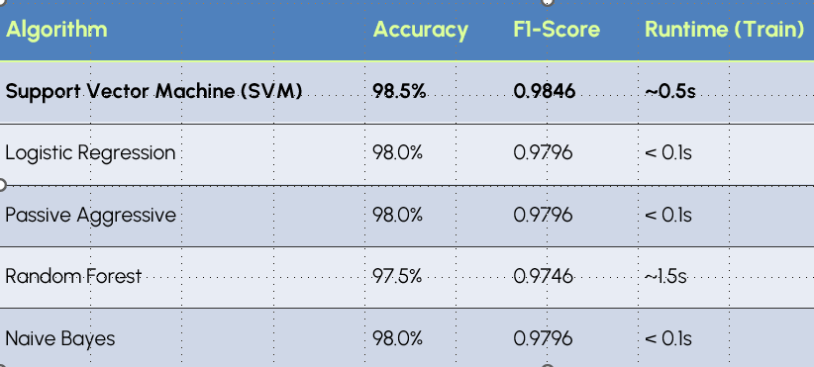
Model Comparison
Comparison of 5 algorithms on the test set (n=200). SVM was selected as the winner.

Slide 6

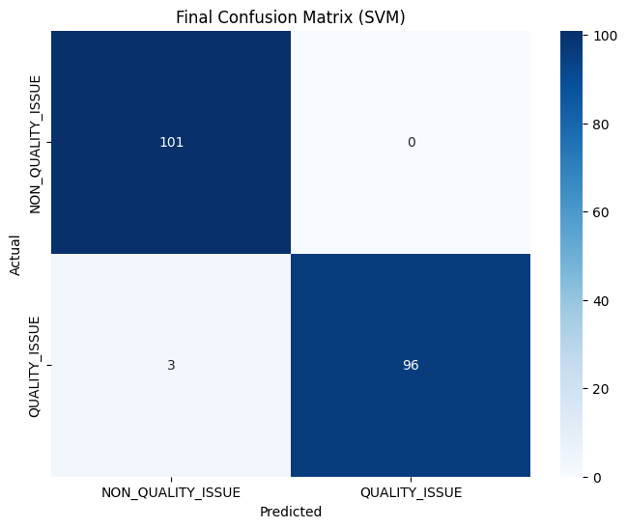
Output: Confusion Matrix
•
:The Confusion Matrix reveals
the model's precision.
Zero False Positives
•
True Negatives (101): Correctly identified all User Errors.
•
True Positives (96): Critical Win. The model never flagged a user error as a machine fault, saving unnecessary technician deployments.
•
False Negatives (3): Only 3 genuine faults were missed.

Slide 7
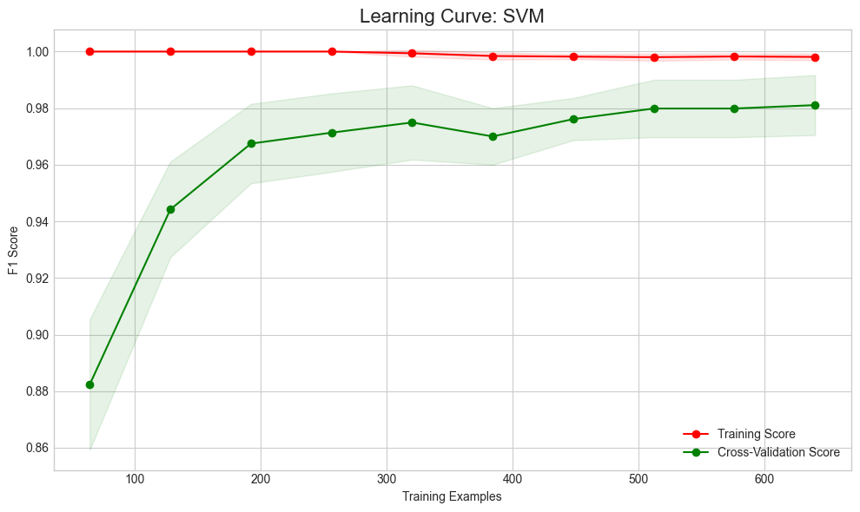


Output: Learning Curve
Bias-Variance Tradeoff
The Learning Curve demonstrates the model’s robustness.
Convergence: The Training Score (Red) and Cross-Validation Score (Green) converge at a high value (~0.98).
Interpretation: The small gap between the lines indicates low variance (no overfitting). The high score indicates low bias (no underfitting).

Slide 8
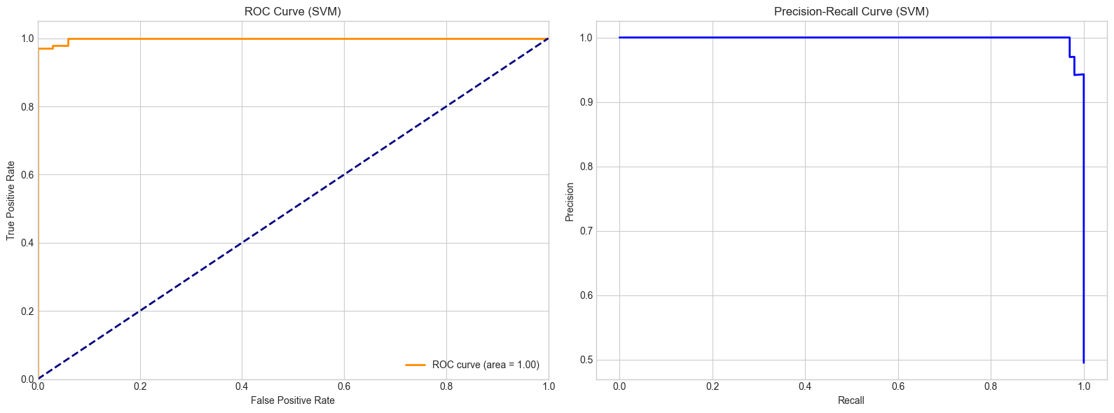
Output: ROC & Precision-Recall
Discriminative Power
ROC = 0.99: The Area Under the Curve is near perfect (1.0), meaning the model has excellent separability between Quality and Non-Quality issues.
Precision-Recall: The curve hugs the top-right corner, maintaining high precision (low false alarms) even at high recall (catching most faults).

Slide 9
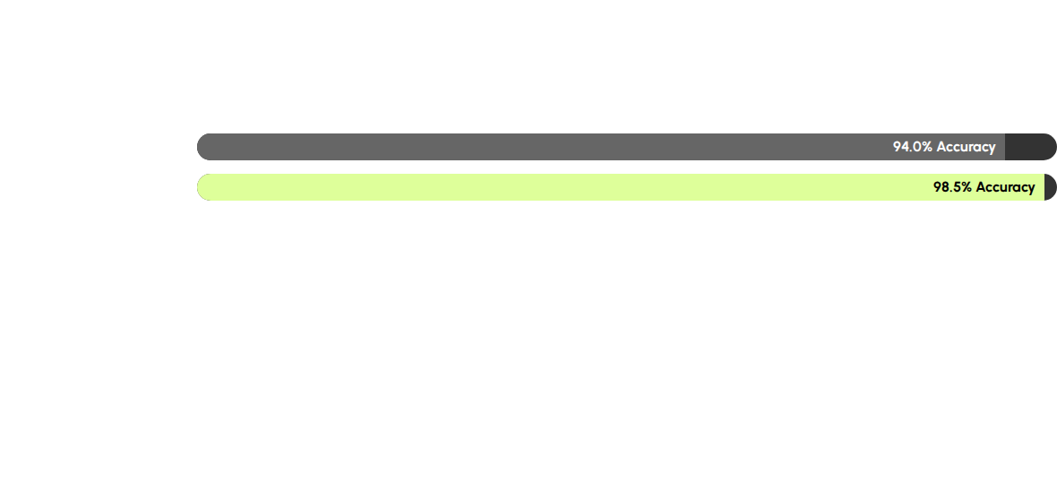


Comparison with Reference Paper
Comparing our SVM approach against the "Passive-Aggressive" baseline from the reference study.
Reference Paper Strategy
Our Strategy
Used Passive-Aggressive Classifiers on multilingual data. Achieved 94% accuracy with 89% F1-Score.
Used SVM with GridSearch on clean English data. Achieved 98.5% accuracy with 98% F1-Score.

Slide 10






Validation Strategy
Stratified Splitting
Ensured the ratio of Quality to Non-Quality issues (50/50) remained identical in both Training and Testing sets to prevent bias.
5-Fold Cross-Validation
The model was trained and tested on 5 different subsets of the data. .
Real-Time Check
The deployment script successfully loads the serialized model and outputs confidence scores,
verifying production readiness.

Slide 11







Tangible Outputs & Identified Gaps
Tangible Outputs
Identified Gaps & Next steps
Future Work
Trained SVM Model .
Functional Streamlit Web App.
Actionable classification logic .
Data Scale: 1,000 records is a small sample. Expansion is needed for deep learning.
Integrate Translation API for multilingual support.
Deploy via Docker containers.
Retrain on larger dataset.
Deployment: Containerize application (Docker) for cloud integration (AWS/Azure).

Slide 12
THANK YOU

